Slide 1
Structural Reform Support Programme
6 June 2019, Tallinn

Slide 2
Agenda
PART I
SRSP: general outline
SRSP: how have we done so far?
PART II
SRSP 2020 roll-out: what you need to know
PART III
Examples of SRSP projects

Slide 3
PART I
SRSP: general outline

Slide 4
Structural Reform Support Service
Offers technical support for design and implementation of structural reforms
Over 760 technical support projects in 26 Member States
https://ec.europa.eu/info/sites/info/files/report-on-the_3-years-of-the-srss_en_.pdf

Slide 5
Structural Reform Support Programme
SRSP: dedicated programme to support Member States with the implementation of structural reforms
For all EU Member States
Based on Member-State requests
Covering a wide range of reform areas, and
The entire life cycle of the reforms, from design to implementation and evaluation
Budget of €222.8 million (2017-2020)
Notes:
The support provided by the SRSS is channelled through a dedicated programme — the Structural Reform Support Programme (SRSP) – set in 2017.
This program, managed directly by the SRSS, enables us to rapidly mobilize, in a flexible manner, expertise from various sources (Member States officials, International Organisations, public agencies, private sector), so that we can offer tailor-made solutions to the Member State needs.
The programme is: - based on MS requests,
- covers a wide scope of reforms
- covers the entire life cycle of the reforms
- is open to all MS

Slide 6
SRSP – total budget allocation*
84.8
79.3
30.5
22.5
3**
In million of EUR
* amounts excluding support expenditure
** preparatory measures

Slide 7
Reform areas (not exhaustive)
Governance and public administration
Governance
Revenue administration, public financial management
Tax administration efficiency
Growth and business environment
Foreign investment & trade policy
Labour market, education, health and social services
Financial sector and access to finance
Central & local administration
e-Government
Management of human resources
Better regulation
Anti-corruption & anti-fraud strategies
Anti-money-laundering strategies
Judicial reform
Spending reviews
Fiscal framework
Budget preparation and execution
Public accounting
SME policy, better regulation
Research, innovation and digital economy
Transport, tourism, agriculture, …
Licensing, inspections, …
Investment management and PPPs
Natural resources
Energy and climate
Labour market
Welfare system
Pension system
Healthcare and long-term care
Education & vocational training
Capital market development
Financial literacy
Financial sector supervision
Insolvency
Crisis management
Insurance undertakings
Tax evasion and fraud
Tax compliance
Tax modelling
Digitalisation

Slide 8
Technical support
Requests linked to government reform and technical support priorities
Member States have ownership of reforms
Clear long-term perspective, focusing on real impact on the ground
Comprehensive package of the most relevant requests for support - smaller number of larger and high quality requests

Slide 9
Our added value
Provision of expertise (not funding) – SRSS is a "strategic partner"
Bringing in the best and most appropriate expertise (combination) and suggesting solutions
Rapid delivery of support, tailor-made to Member State’s needs
No co-financing required

Slide 10
How we work
Sources
Commission services
Instruments
Expert missions (short-term, long-term, embedded)
Support
Scoping missions, EU benchmarking
Member States' officials (TAIEX)
Public agencies
International Organisations
Private sector
Study visits
Analysis (legal, processes, IT, etc.)
Reform partnerships
Seminars, conferences, workshops, training
Peer-to-peer exchanges
Consultancy (legislation, communication, data analysis, change management…)
Reform design, strategic support
Commission services
Member States' officials (TAIEX)
Public agencies
International Organisations
Private sector
Expert missions (short-term, long-term, embedded)
Study visits
Analysis (legal, processes, IT, etc.)
Reform partnerships
Scoping missions, EU benchmarking
Seminars, conferences, workshops, training
Peer-to-peer exchanges
Consultancy (legislation, communication, data analysis, change management…)
Reform design, strategic support
10

Slide 11
PART I
SRSP:
how have we done so far?

Slide 12
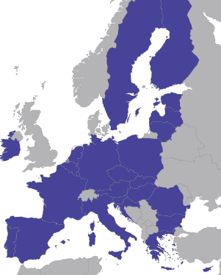
SRSP coverage

Slide 13
Comparison with previous rounds
SRSP 2017 | SRSP 2018 | SRSP 2019
EUR 22.5 million | EUR 30.5 million | EUR 79.3 million
271 requests received (for EUR 80 million) | 444 requests received (for EUR 150 million) | 580 requests received (for EUR 194 million)
159 requests selected | 147 requests selected | 263 requests selected
16 Member States | 24 Member States | 26 Member States
Average project size: EUR 140,000 | Average project size: EUR 207,000 | Average project size: EUR 303,000

Slide 14
Projects per Member State (2017-2019)

Slide 15
… per circumstances (2017-2019, in nbr)

Slide 16
… per policy area (2017-2019, in nbr)

Slide 17
PART II
SRSP 2020 roll-out:
what you need to know

Slide 18
SRSP 2020 roll-out
SRSS ready to help with initial drafting of request (well in advance)
Deadline for submitting requests: 31 October 2019 -> BUT earlier internal deadline!
Submission through the national Coordinating Authorities, through a web portal (SRSS portal)
Prioritisation of requests at national level

Slide 19
SRSP 2020 roll-out calendar
Spring – early autumn
Preparatory work on priority requests
Nov - Dec 2019
Analysis of requests and selection of the SRSP 2020 projects
Spring 2020
Projects launched on the ground
31 Oct 2019
Deadline for submission of requests under SRSP 2020
Feb 2020
Annual Work Programme and
Cooperation and Support Plans

Slide 20
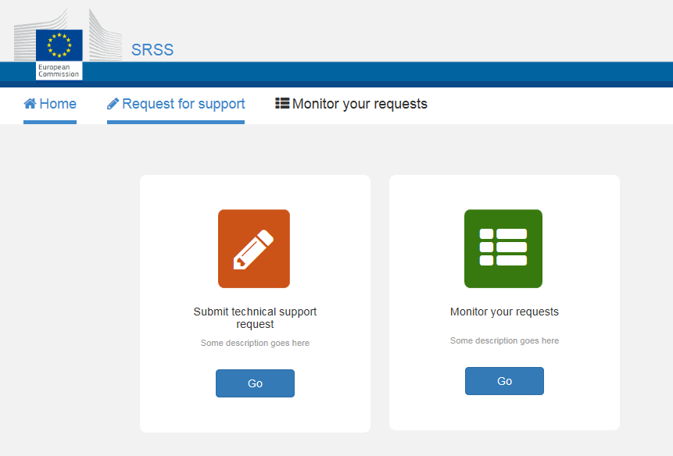
Submission of requests – SRSS portal
https://webgate.ec.europa.eu/SRSS-portal

Slide 21
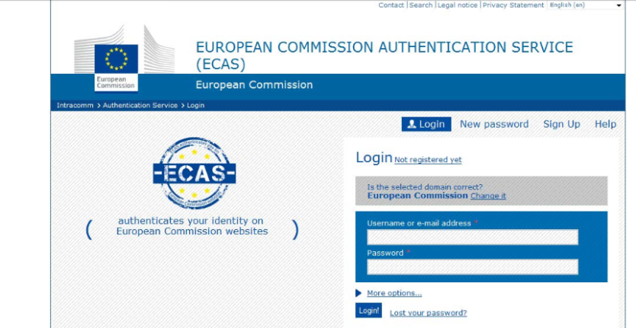
Step 1 - Registration
1. Coordinating Authorities and beneficiaries to register on ECAS (https://webgate.ec.europa.eu/ecas)
Advised: one account per Coordinating Authority and one account per beneficiary (functional mailbox for ex.)
2. Communicate the email registered to the SRSS (SRSS-SRSP@ec.europa.eu)

Slide 22
Step 2 – Logging in
1. SRSS provides access 2. Member States log on to the web interface
https://webgate.ec.europa.eu/SRSS-portal

Slide 23
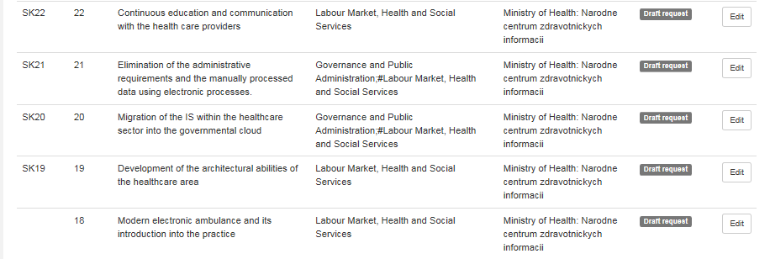
Edit, monitor and send your requests

Slide 24
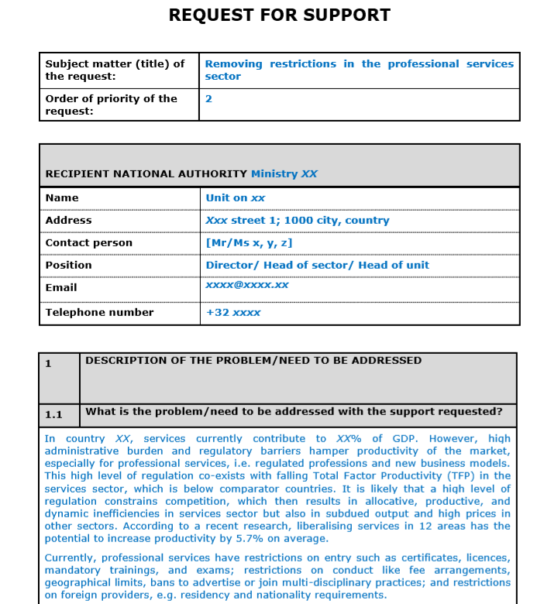
Filling out a request for support

Slide 25
Filling out a request for support
DESCRIPTION OF THE PROBLEM/NEED TO BE ADDRESSED
1.1 What is the problem/need to be addressed with the support requested?
1.2 Breadth of the problem/need
1.3 Depth of the problem/need
1.4 Urgency of the request for support
1.5 Socio-economic indicators

Slide 26
Filling out a request for support
2. DESCRIPTION OF THE SUPPORT MEASURES REQUESTED AND ESTIMATED COST
2.1 Description of the support measures requested
2.2 Indicative duration and estimated cost
2.3 Expected results /use of the results
2.4 Administrative capacity of the Member State
2.5 Envisaged provider(s) (if applicable)
3. CIRCUMSTANCES OF THE REQUEST
4. EA MEMBERSHIP SUPPORT

Slide 27
Filling out a request for support
Model Application Form: Template SRSP 2019.docx
Guidance and example: SRSP_instructions 2019_Ares.pdf

Slide 28
How do we analyse requests?
Assessment criteria (from the SRSP Regulation) (urgency, breadth & depth, reform needs, administrative capacity)
Criteria related to sound financial management (maturity, focus and expected results)
Prioritisation by the Member States
Added value and impact on the ground
Check for no overlap (the action proposed cannot be financed by other EU funding programmes)

Slide 29
QUESTIONS?

Slide 30
PART III
EXAMPLES OF SRSP PROJECTS

Slide 31
Independent analysis of the Prosecutor's Office in Bulgaria
for the Ministry of Justice and the Public Prosecutor's Office
The Commission provided technical support by carrying out an independent analysis of the Public Prosecutor's Office.
Context
The national authorities sought to perform an analysis of the structure and independence of the Public Prosecutor's Office. The objective was to contribute to the implementation of a Strategy for Judicial Reform.
Support delivered
The SRSS coordinated a team of five prosecutors from Germany, the Netherlands, Spain and the UK (2), who delivered technical support over a period of 9 months.
The support measures consisted of:
drafting recommendations to implement European standards; and
analysing human resource management, efficiency, independence and accountability of the Public Prosecutor's Office.
Results achieved
Support from the SRSS delivered the following results:
more than 60 precise and concrete recommendations to support the authorities in implementing European standards; and
analysis of the independence and efficiency of the Public Prosecutor's Office.
And had the following impacts:
in response to the recommendations prepared through the SRSS support by the experts, in July 2017, the national authorities set out a joint roadmap covering both organisational and potential legislative measures. The roadmap is currently being implemented.

Slide 32
Strengthening the effectiveness of the judicial system in Croatia
for the Ministry of Justice
The Commission supported national authorities in their efforts to improve the country's court management to underpin an effective judicial system and respect for the rule of law.
Context
The Ministry sought to improve the effectiveness of the judicial system and to ensure respect for the rule of law as a prerequisite for encouraging investment and creating a business-friendly environment. This required reforming national legislation in order to establish more efficient court management and ensure a better quality judicial system.
Support delivered
The SRSS mobilised several judges from France, the Netherlands and Slovenia to share their national practices with the Croatian authorities.
The support measures focused on the following elements:
management of the court administration;
individual evaluation of judges; and
statuses/certifications of court professionals assisting the court (e.g. court experts, court interpreters, and certified appraisers).
Results achieved
Support from the SRSS delivered the following results:
finalisation of the design of several laws currently being prepared by the Ministry, e.g. on the management of courts, the evaluation of judges and on court professionals to support the implementation of Croatia's justice strategy.
And had the following impacts:
a more effective judicial system.
Notes:
Example in the governance and public administration area, judicial sector in particular
Supporting Cratia's justice strategy with the view of establishing a more efficient court management and ensure a better quality judicial system
Assiting the authorities in designing laws on the management of courts, evaluation of judges and court professionals
Example of sharing of best practices between experts across several other Member States

Slide 33
Setting up an independent revenue
Agency in Greece
for the national Revenue Authority
The Commission supported national authorities in their efforts to establish an independent agency for public revenue.
Context
The national authorities wished to establish an independent revenue authority with its own financial, organisational and human resources, free from political influence. The previous systems had limited the performance and efficiency of the national revenue administration.
Support delivered
The support was provided by the SRSS over 18 months and consisted of:
designing the minimum requirements for autonomy to enable the Independent Agency for Public Revenue to operate efficiently and to implement modern working methods;
providing guidance during the drafting phase of the legislation setting up the Independent Agency for Public Revenue – in line with best international practice and national constitutions; and
providing support during the setting-up of the Independent Agency for Public Revenue in the fields of IT services, human resources, tax compliance and debt collection.
Results achieved
The SRSS support delivered the following results:
establishment of the Independent Agency for Public Revenue.
And had the following impact:
created an independent public revenue administration;
created a new public revenue model designed to modernise and increase the efficiency of audits and tax collection ; and
established best practice for the set-up of future organisations.

Slide 34
Awareness campaign strategy to reduce shadow economy in Lithuania
for the Lithuanian government and the State Tax Inspection (STI)
The Commission supported national authorities in their fight against tax evasion and shadow economy by designing a comprehensive communication campaign strategy and all its necessary elements to support its implementation by the government.
Context
The Lithuanian authorities sought to organise an awareness-raising campaign to reduce shadow economy in Lithuania, to accompany the launch of the foreseen reform. The objective was to provide them with a fully functioning, turnkey communication strategy, including all elements needed to favour the ownership and support the implementation team in Lithuania.
Support delivered
The support provided by the SRSS and a private provider (Communication agency) was delivered in the form of tailored expertise and consultancy over 9 months.
The support measures consisted of:
Research and preparatory analysis of the national context in which the campaign would take place, to set the scene and to define the most customised and relevant strategic approach;
Development of a comprehensive and tailor-made communication strategy and;
Support to the implementation (training and hotline) and monitoring (KPIs)].
Results achieved
Support from the SRSS delivered the following results:
Full-fledged awareness strategy delivered and ready for implementation (campaign and videos immediately launched) with effective budget and monitoring tools (KPIs)
And had the following impacts:
Strengthened capacity of the Lithuanian Authorities in developing such key awareness actions and impact on taxpayers' compliance

Slide 35
Explanatory and feasibility study on state-of-the-art and new technologies in Belgium
for the implementation of an enhanced supervision of the container supply chain by the Belgian Customs
The Commission is supporting the Belgian Customs in their efforts to modernise the supervision of the container supply chain and address current major threats by identifying and using efficiently the most advanced state-of-the art technologies.
Context
With the increase of international trade, especially through container support, the Belgian Customs are facing unprecedented and increased threats and challenges which have a huge impact on safety and security. The situation has to be primarily addressed in the port of Antwerp and requires to explore and assess new and state-of-the art technologies in terms of feasibility and potential cost and benefit in this context.
Support delivered
The support provided by the SRSS and experts from the private sector was delivered over 18 months.
The support measures consisted of:
A data collection and exploratory study to identify the most appropriate and fitting new state-of-the art technologies in terms of efficiency, effectiveness and adaptability to Customs needs of enhanced supervision of the container chain;
A technology and economic feasibility study aimed at assessing the investment and running cost of the scenarios identified as potentially technologically suitable;
An impact analysis on the supply chain and trade impact;
Proposal, guidance and recommendations for implementation of the most suitable technologies.
Results achieved
Support from the SRSS delivered the following results:
Identification of the most appropriate and suitable technologies;
Confirmation that a combined multi-layered technology approach will be needed;
Identification of high potential areas for further improvement;
Practical tangible technology solution proposed and delivered;
Full cost & benefit analysis, guidance and roadmap for investment and proposed implementation.

Slide 36
Treasury Single Account
in Portugal
for the Ministry of Finance
The Commission is supporting national authorities in their efforts to improve the functioning of their Treasury Single Account.
Context
The Ministry of Finance intends to use the momentum of the reform of the budget framework law and the additional information provided by the new framework to modernise cash management and enhance its capacity to forecast non-tax revenue.
Support to be delivered
The support provided by the SRSS and the World bank will take the form of on-site missions and workshops.
The planned measures consist of:
reviewing the functions of the Debt and Treasury Management Agency;
developing a new cash management model;
streamlining non-tax collection and accounting procedures; and
providing recommendations for improvements in the architecture of the Financial Management Information System.
Expected results
Support from the SRSS is expected to deliver the following results:
more effective cash management;
improved non-tax revenue collection and accounting.
And to have the following impact:
reduced level of debt and hence costs of borrowing; and
fostering sound financial management.

Slide 37
Enhancing the Entrepreneurial Ecosystem in Cyprus
for the Ministry of Energy, Commerce, Industry and Tourism and the Presidency of Cyprus
The Commission supported Cyprus to boost the competitiveness of the economy by enhancing the entrepreneurial ecosystem.
Context
Entrepreneurship was identified as one of the main pillars of economic growth and prosperity in the country and listed in the national Action Plan for Growth.
In 2015, the Government adopted the "National Policy Statement on Enhancing the entrepreneurial Ecosystem".
Support delivered
The SRSS support consisted of:
inputs to the policy development;
contributions to the action plan for social entrepreneurship;
support for the Global Entrepreneurship Monitor survey;
exchange of best practices on the digitisation of grant schemes; and
study and recommendations to improve on export performance.
Results achieved
creation of a governance body to implement the Policy Statement;
implementation of over 50% of all actions in the policy statement ;
the drafting of a law and action plan on social entrepreneurship;
entry of Cyprus in the Global Entrepreneurial Monitor;
creation of StartUp Visa;
enhanced for support to export-oriented enterprises; and
introduction of incentives for innovative firms.

Slide 38
Strategic roadmap for the industry digitisation initiative in Lithuania
for the Ministry of Economy and Innovation
The Commission supported national authorities in their efforts to develop a strategic roadmap for digitisation of industry in Lithuania, in close collaboration with the national multi-stakeholder platform for championing industry digitisation reforms.
Context
A favourable environment for cooperation among industry, business, academia and public authorities is needed to encourage the digitisation of industry. Digitisation will enable Lithuania's industry to remain competitive on the international stage and to contribute to more rapid growth in Lithuania's economy.
Support to be delivered
The SRSS provided support over a 6-month period in the form of technical advisory services by entities with substantial experience in industry platforms for digitisation.
The support measures consisted of:
benchmarking against best practices in other EU Member States and identifying challenges and opportunities for Lithuania;
formulating recommendations; and
developing a strategic roadmap for the digitisation of industry in Lithuania.
Results achieved
The Ministry formally adopted the Lithuanian Industry Digitisation Roadmap 2019-2030 in March 2019.
Implementation of the roadmap is expected to have a major positive impact on the competitiveness and productivity of Lithuania's industry.
The support from the SRSS helped the Ministry secure funding from the EU's structural and investment funds to implement the strategic roadmap. Additional funding has been mobilised from Lithuania's private sector.

Slide 39
Strengthen the energy efficiency and renewables framework
for the Ministry of Environment and Energy
The Commission supported national authorities in their efforts to improve the country’s framework for energy efficiency and renewables and to meet the national targets for 2020.
Context
The Ministry sought to promote energy efficiency and the use of renewable energy, in order to achieve the country’s potential in both areas. This required full implementation of relevant national and EU legislation, as well as improvements in the existing regulatory framework.
Support delivered
The SRSS mobilised experts from the German development agency, GIZ, who were based at the Ministry for a period of 22 months.
The support measures consisted of:
identifying barriers to investment, market integration of renewables, financing of energy efficiency, etc.;
benchmarking against EU best practices;
providing tailor-made recommendations for changes in the national regulatory frameworks; and
targeted training for energy managers and other stakeholders.
Results achieved
The SRSS support delivered the following results:
a new market-based support scheme to incentivise use of renewable energy;
a new energy efficiency obligation scheme; and
new energy audit scheme.
And had the following impact:
a more robust energy efficiency and renewables’ framework; and
new competences for public energy managers and other stakeholders in the field of energy efficiency and renewables.

Slide 40
Setting up a Guaranteed Minimum Income scheme in Greece
for the Ministry of Labour and Social Protection
The Commission supported national authorities in their efforts to set up a guaranteed minimum income scheme designed to provide a last resort safety net for disadvantaged groups, reduce poverty and increase social inclusion.
Context
Before the introduction of a guaranteed minimum income scheme, much of the poorest section of the population received either no benefits or benefits provided on an ad-hoc basis. The guaranteed minimum income scheme now provides financial support for disadvantaged groups that meet the eligibility conditions, while promoting quality access to social services and creating incentives to seek work.
Support delivered
The support provided by the SRSS and the World Bank was delivered over 2 years in the form of short-term expert missions and long-term presence of experts on the ground.
The support measures consisted of:
preparing the legislation setting up the guaranteed minimum income;
implementing, monitoring and evaluating the guaranteed minimum income scheme; and
training officials responsible for the implementation of the scheme.
Results achieved
Support from the SRSS delivered the following results:
roll-out of the national guaranteed minimum income scheme; and
better monitoring and assessment of welfare benefits.
And had the following impact:
reduction in poverty and better access to social services; and
improved administrative capacity of the Ministry in charge of the scheme.

Slide 41
Assessing health system performance in Latvia and Slovenia
for the Ministries of Health
The Commission is supporting national authorities in their efforts to develop and implement frameworks for assessing the performance of their health systems.
Context
National health authorities intend to develop tailored frameworks to assess the performance of their health systems and to apply them to monitor and evaluate upcoming health reforms.
Support delivered
The support provided by the SRSS is delivered jointly to Latvia and Slovenia over 24 months in the form of continuous technical advice.
The support measures consist of:
organising trainings and country visits;
identifying key dimensions to be targeted by the assessment (e.g. efficiency, access, quality of care);
identifying and developing explanatory indicators for each dimension; and
involvement of relevant stakeholders in the implementation of the assessments.
Expected results
Support from the SRSS aims at the following results:
develop tailored frameworks for the assessment of health system performance; and
use those frameworks to assess health sector reforms.
And will have the following impact:
improved performance of the health systems;
increased local capacity of assessing the performance of the system; and
better health of the population.

Slide 42
Implementation of the
curricular reform in Croatia
for the Ministry of Education
The Commission is supporting national authorities in their efforts to achieve a successful implementation of a comprehensive reform of the curriculum.
Context
As the newest member of the EU, Croatia seeks to improve its educational system to reach the standards of some of its European partners.
The Comprehensive Curriculum Reform is the cornerstone of the Croatian National Strategy for Education, Science and Technology. It encompasses all levels of education, interconnects them and introduces learning outcomes and the development of competencies.
Support delivered
The support provided by the SRSS is implemented by the British Council over 12 months, and mobilises experts from different countries (EE, FI, NL, New Zealand, SI, the UK).
The support measures consist of:
conducting a review of key curriculum documents;
developing training and coaching resources, including audio-visuals for teachers and leaders;
training teachers and coaches; and
designing a delivery model for the Comprehensive Curriculum Reform in pilot schools.
Results achieved
The SRSS support delivered the following results:
implementation of a new training framework for teachers and coaches; and
teachers and coaches prepared to teach specific competencies according to the Comprehensive Curriculum Reform in pilot schools.
And is expected to have the following impact:
Smooth and effective implementation of the pilot phase of the Comprehensive Curriculum Reform in Croatia.

Slide 43
Design of a tool to forecast the need for teachers in Lithuania
for the Ministry of Education and the Research and Higher education Monitoring and Analysis Centre
The Commission is supporting national authorities in their efforts to address mismatches between the need for teachers and the supply, and eventually improve the quality of teaching.
Context
In view of the likely shortfall of teachers in the coming year, the Ministry seeks to develop a tool that will allow better prediction of the future need for teachers in different regions, subjects, and level of education. This will in turn allow a better allocation of budgetary resources and more accurate planning of Higher Education programmes for initial teachers' training.
Support delivered
The SRSS mobilised experts from the UK and Ireland to support the national team working on the elaboration of a new prospective tool, over a period of 12 months, by providing:
examples of relevant tools;
technical support to develop and implement a pilot forecasting the demand for teachers; and
recommendations for more effective policy making in the field of teaching.
Expected results
The SRSS support is expected to deliver the following results:
elaboration and testing of a pilot forecasting model;
recommendations for the use of its results in teacher-related policies.
With have the following impact:
reduced mismatch between the need for teachers and the supply;
higher attractiveness of the teaching profession; and
better quality education.

Slide 44
Reforming the assessment of disability
in Czech Republic, Greece and Poland
The Commission is supporting several national authorities in their efforts to (i) modernise the administrative processes in the field of disability assessment, and (ii) review the disability assessment by moving from a medical impairment-based approach towards a more holistic assessment of disability which takes into account functional capacity and individual circumstances.
Context
In ageing societies, the benefits and services in place for those who have difficulties in working up to retirement age become increasingly important.
In general, disability assessment and policies should support inclusive societies and labour markets, in line with the UN Convention on the Rights of People with Disabilities.
Support delivered
The support provided by the SRSS was related to both (1) the review of organisational & administrative processes; and (2) the reform of the assessment methodology.
Support was provided in the following areas:
organisational development;
review of business & IT processes;
communication & customer services;
human resources: training needs analysis & programme;
review of the assessment methodology; and
design of a pilot programme.
Expected results
The support from the SRSS is expected to deliver the following results:
review and upgrade of business and IT processes;
design of a pilot programme; and
development of human resources & communication strategies.
And have the following impact:
fair and transparent procedures; and
reduced administrative burden and waiting times.

Slide 45
Risk-based Financial Supervision in Romania
for the Financial Services Authority
The Commission is supporting national authorities in their efforts to foster a more risk-based approach to financial markets supervision.
Context
The national authorities sought to promote risk based supervision and regulate financial markets in line with these principles.
This required changing supervisory practices and improvements in the existing regulatory framework.
Support delivered
The support provided by the SRSS and the World Bank team, including contracted experts, is being delivered over a two-year period.
The support measures consist of:
multiple missions to interview and consult and to road-test supervisory practices with the staff;
delivering draft laws, supervisory manuals and templates; and
supervisory workshops.
Expected results
Support from the SRSS is expected to deliver the following results:
better risk-based supervision of Romania's financial markets.
And have the following impact:
more efficient and focussed regulation of and enforcement in national financial markets.

Slide 46
Managing Non-Performing Loans in Slovenia
for the banking sector supervisor
The Commission supported national authorities in their efforts to reduce the large volume of non-performing loans (NPLs) in the small-and medium-size-enterprise (SME) sector and to improve the functioning of the national banking system.
Context
The high level of non-performing loans (NPLs), in the SME sector in particular, limits banks' ability to provide credit. In order to reduce the volume of NPLs in the country's SME sector, the national banking sector supervisor decided to develop a comprehensive strategy to restructure these types of NPLs.
Support delivered
The support provided by the SRSS and the World Bank was delivered over 9 months in the form of expert missions and data analysis.
The support measures consisted of:
developing a toolkit for banks on how to deal with NPLs, while also laying out restructuring options for each loan category;
providing guidance on how to organise loan restructuring processes within a bank; and
training professionals dealing with NPLs.
Results achieved
The SRSS support delivered the following results:
guidelines and a handbook on how to deal with NPLs; and
a workshop on NPLs for banking professionals.
And had the following impact:
strengthened both the supervisor's and banks' ability to deal with NPLs in the SME sector.

Slide 47
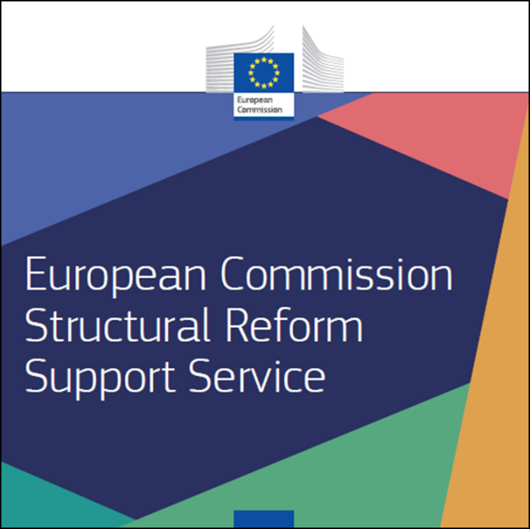
Contacts
Main contact:
Structural Reform Support Programme: SRSS-SRSP@ec.europa.eu
Website:
https://ec.europa.eu/info/departments/structural-reform-support-service_en

Slide 48
THANK YOU

